Slide 1
Credit Card Fraud Detection
Saira Faiz, Harshilkumar Pareshbhai Kansara, & Colby Jamieson

Slide 2
Can we predict which credit card transactions are fraudulent?
Date | Posted Transactions | Amount
December 1, 2021 | U of A CAB TIMS | $4.60
 | ESSO | $50.00
December 4, 2021 | Etsy | $45.55
 | EDM EPark | $2.00
December 5, 2021 | Sephora Canada | $39.75
 | UAlberta Bookstore | $55.66
 | U of A CAB TIMS | $4.60

Slide 3

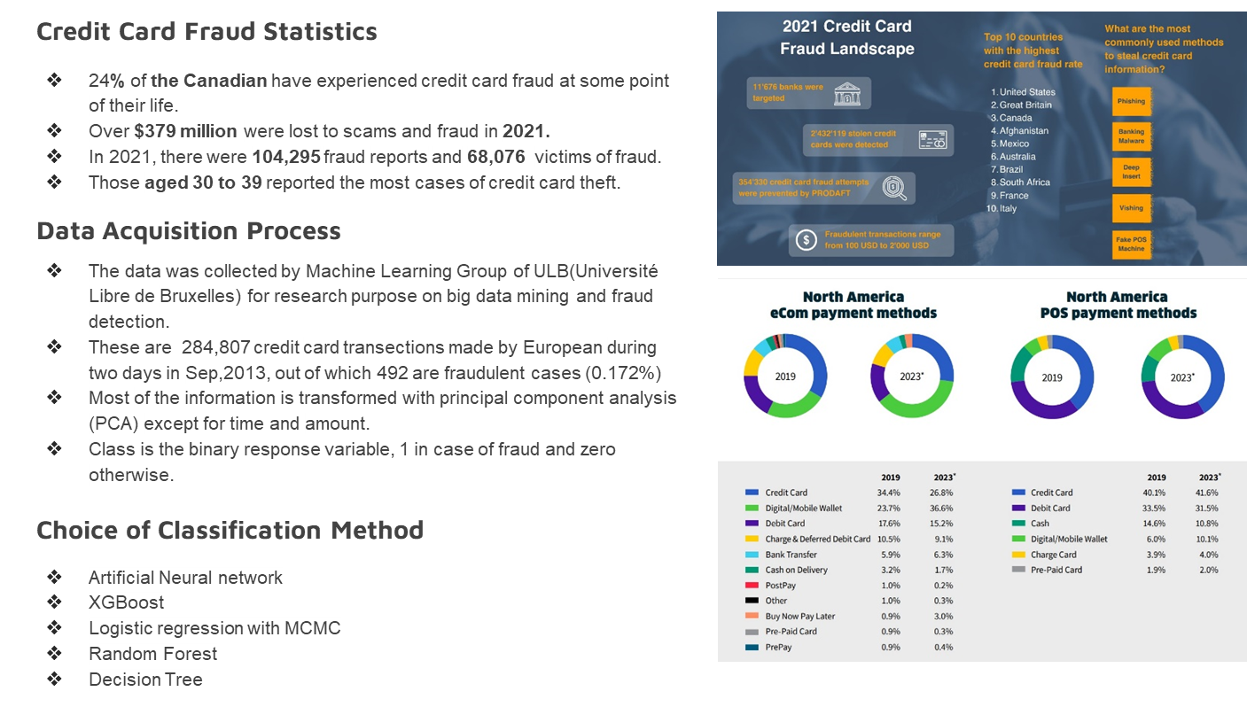

Slide 4
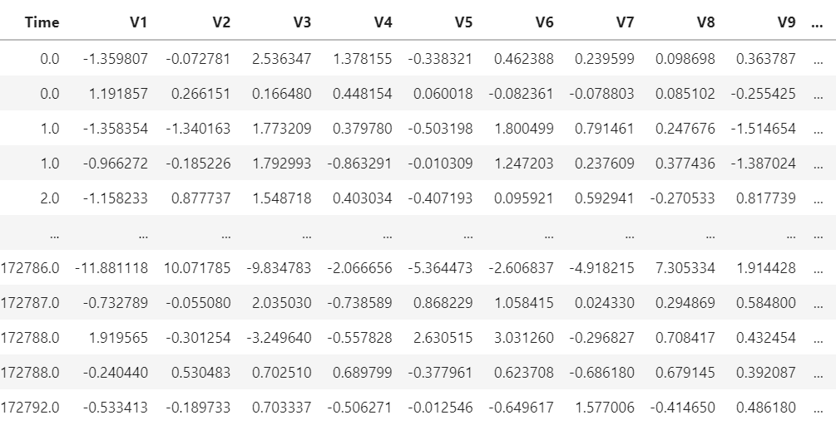
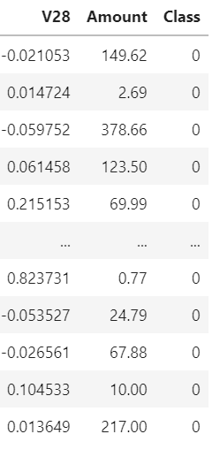
Data

Slide 5
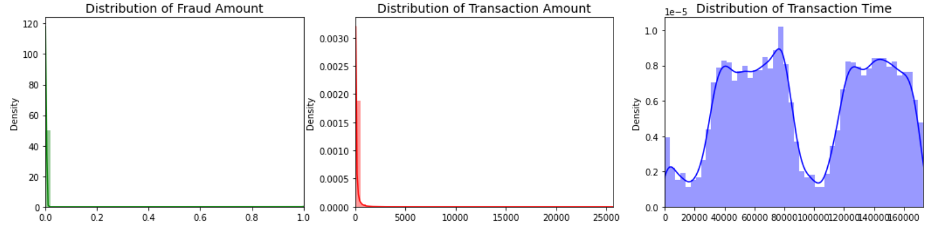
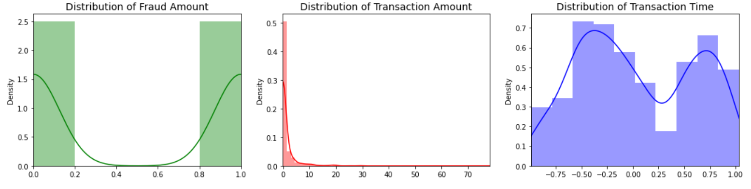
Transforming Unbalanced Data

Slide 6
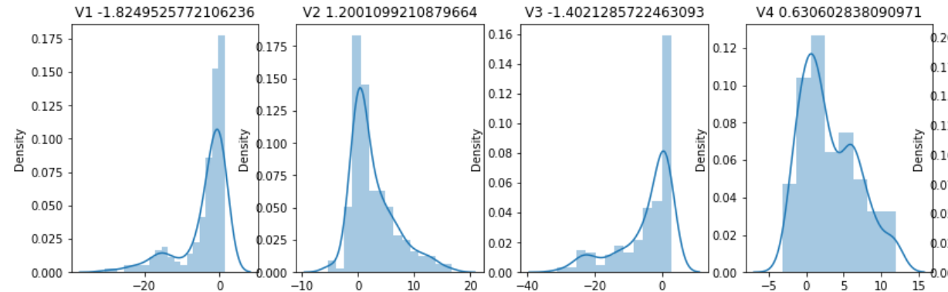
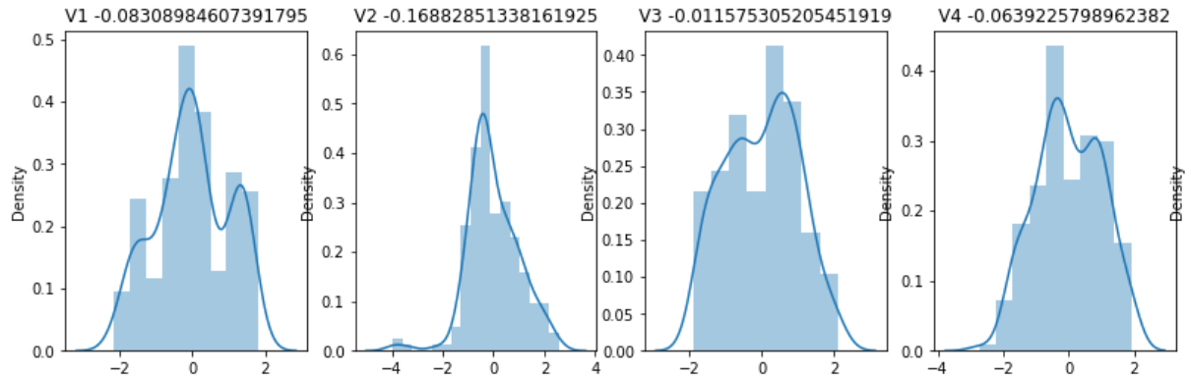
Transforming Skewed Data

Slide 7
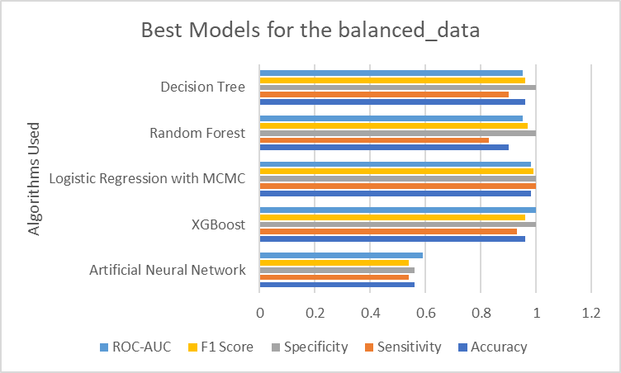
Best Model for our Balanced Data

Slide 8
Future Work
This data was used with the PCA transformed data as given V1 to V28 as the bank data are confidential. We would like to use a more comprehensive data in the future for our analysis.
Model building using different deep learning methods such as CNN, RNN and see the accuracy on the unbalanced as well as balanced data.
Model building using different classification techniques such as KNN, Naive Bayes, Support Vector Machine etc.
MCMC approach was quite affective while applying it to the logistic regression method, we would like to apply it to different algorithms and see the accuracy.

Slide 9
Questions?

